Slide 1
Paper Reading Group
vision@ouc
Li Na
CVPR 2017
2017.7.22

Slide 2
Articles List
1.Fast Haze Removal for Nighttime Image Using Maximum Reflectance Prior
2.WaterGAN: Unsupervised Generative Network to Enable Real-time Color Correction of Monocular Underwater Images

Slide 3
Title and Authors
Fast Haze Removal for Nighttime Image Using Maximum Reflectance Prior
Jing Zhang,
Yang Cao,
University of Science and Technology of China Hefei

Slide 4
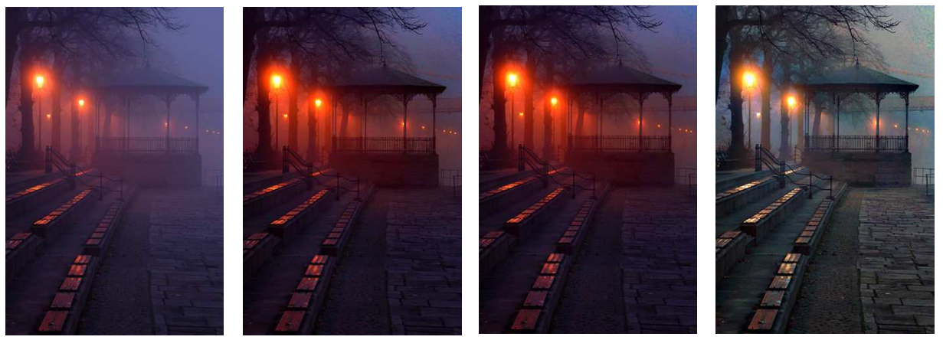
Abstract
Propose a simple but effective image prior, maximum reflectance prior to estimate the varying ambient illumination.
For the nighttime haze image, the local maximum intensities at each color channel are mainly contributed by the ambient illumination.

Slide 5
Introduction
The hazy images suffer from significant visibility degradation:
the attenuation of the direct reflection light
the accumulation of the scattering ambient light.
Daytime hazy imaging model and priors do not hold for most nighttime hazy scenes.
assume the ambient illumination is globally consistent.
estimate a white ambient light from the brightest region in the image.

Slide 6





The goal:
Estimate the ambient illumination and the atmospheric transmission for each pixel
the direct attenuation term
the nighttime hazy imaging model
varicolored ambient illumination
the scattering term
non-uniform ambient illumination

Slide 7
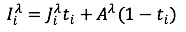
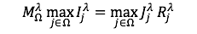

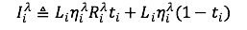
Maximum reflectance prior

Slide 8
Nighttime image dehiring
Estimation of ambient illumination
Haze removal
A Faster Approximated Estimation Method

Slide 9
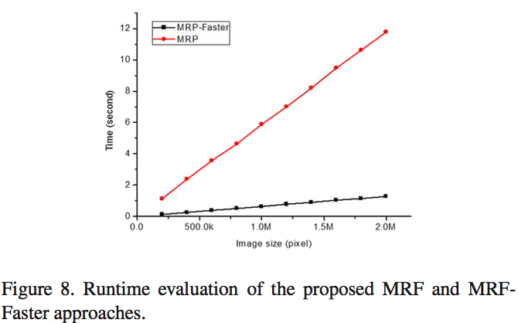
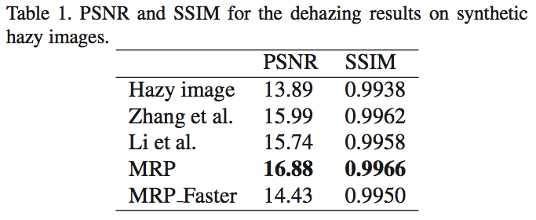
Experimental results and discussion
Results on intermediate hazy image estimation
Qualitative comparisons on real images
Quantitative comparisons on synthesized images
Runtime evaluation

Slide 10
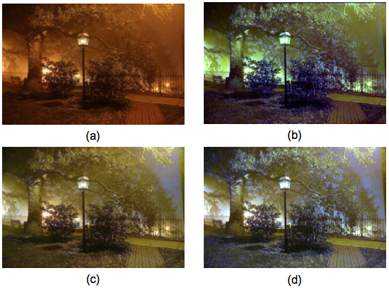
Discussion and Conclusion
When the scene objects are inherently with solely distinct color, the maximum reflectance prior becomes invalid.
The proposed scheme will generate color distortions for these objects, such as the grasses and leaves in Fig.

Slide 11
Title and Authors
WaterGAN: Unsupervised Generative Network to Enable Real-time Color Correction of Monocular Underwater Images
Jie Li,
Katherine A. Skinner,
Ryan M, Eustice
Matthew Johnson-Roberson

Slide 12
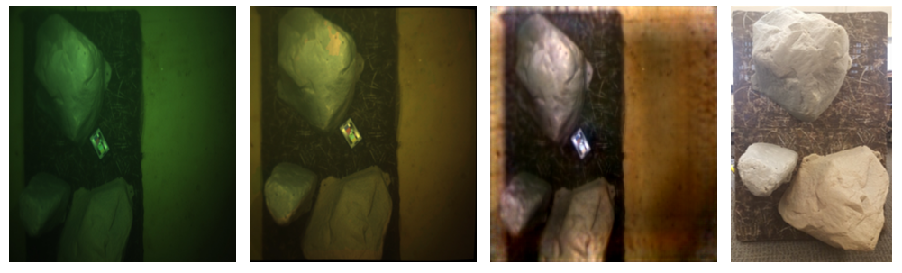
Abstract
Using WaterGAN, we generate a large training dataset of paired imagery, both raw underwater and true color in-air, as well as depth data.
This data serves as input to a novel end-to-end network for color correction of monocular underwater images.
The end-to-end network implicitly learns a coarse depth estimate of the underwater scene from monocular underwater images.
日期

Slide 13
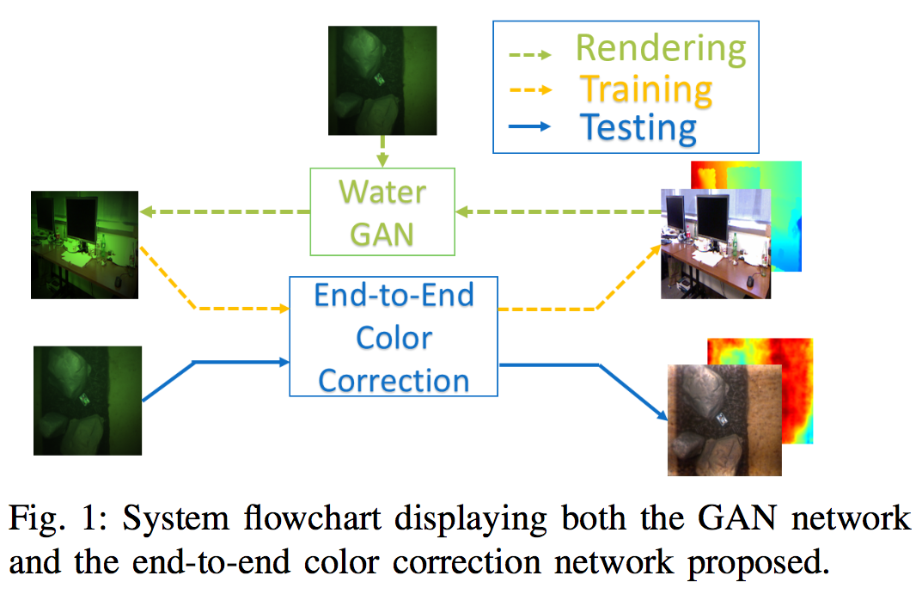
Technical approach
Two-part:
Generating Realistic Underwater Images
End-to-end model Learning

Slide 15
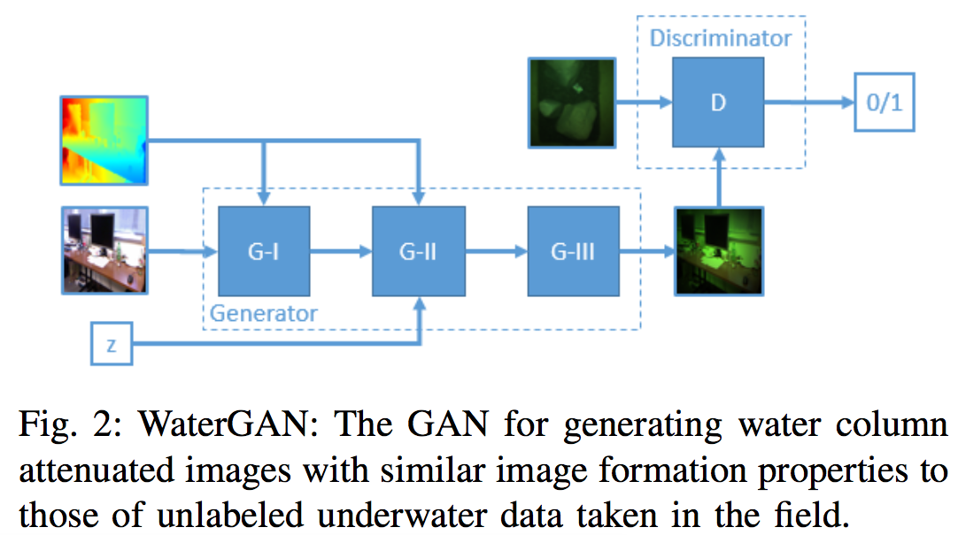
Two networks training:
a generator G, and a discriminator, D
Three main stages:
attenuation(G-1)
scattering(G-2)
vignetting(G-3)
Input: RGB-D
and alter the color and intensity
not alter the structure or texture

Slide 16
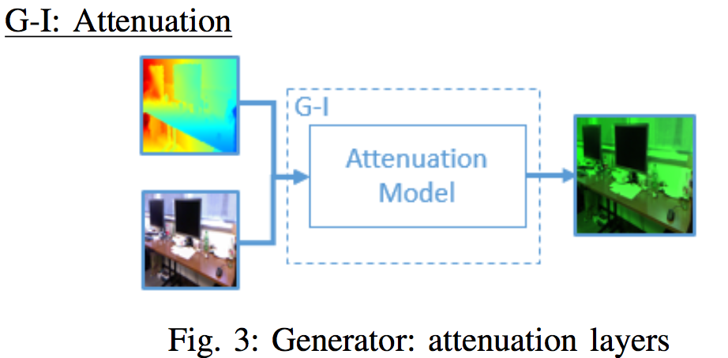
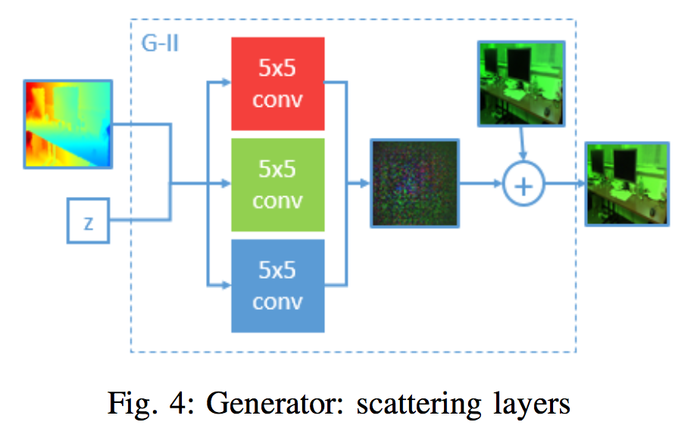
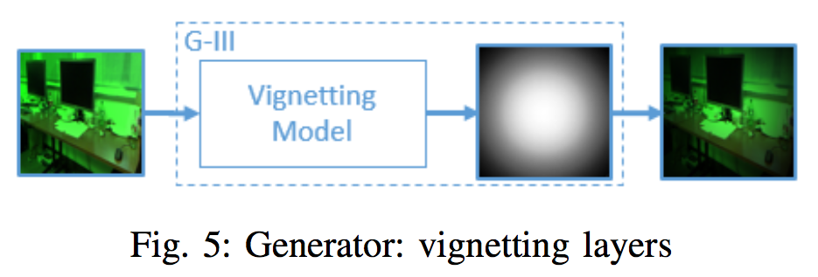
range-dependent attenuation of light
Jaffe-McGlamery model
公式
backward scattering
a characteristic haze effect model:
公式：
vignetting model
a shading pattern around the borders of
an image due to effects from lens

Slide 17
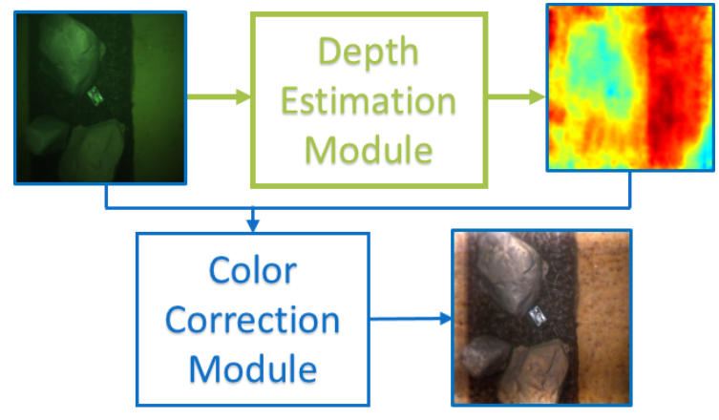
Module1 ：
estimates depth from underwater images using the information encoded in attenuation.
Module2 ：
takes that estimated depth and inverts the underwater image formation process.

Slide 18
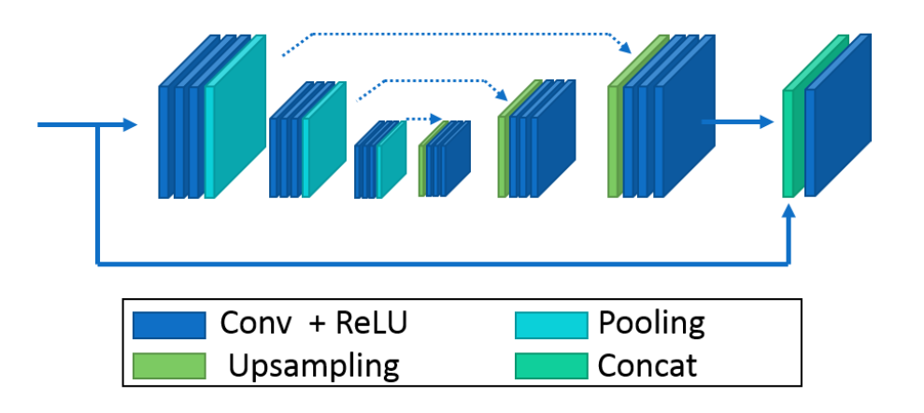
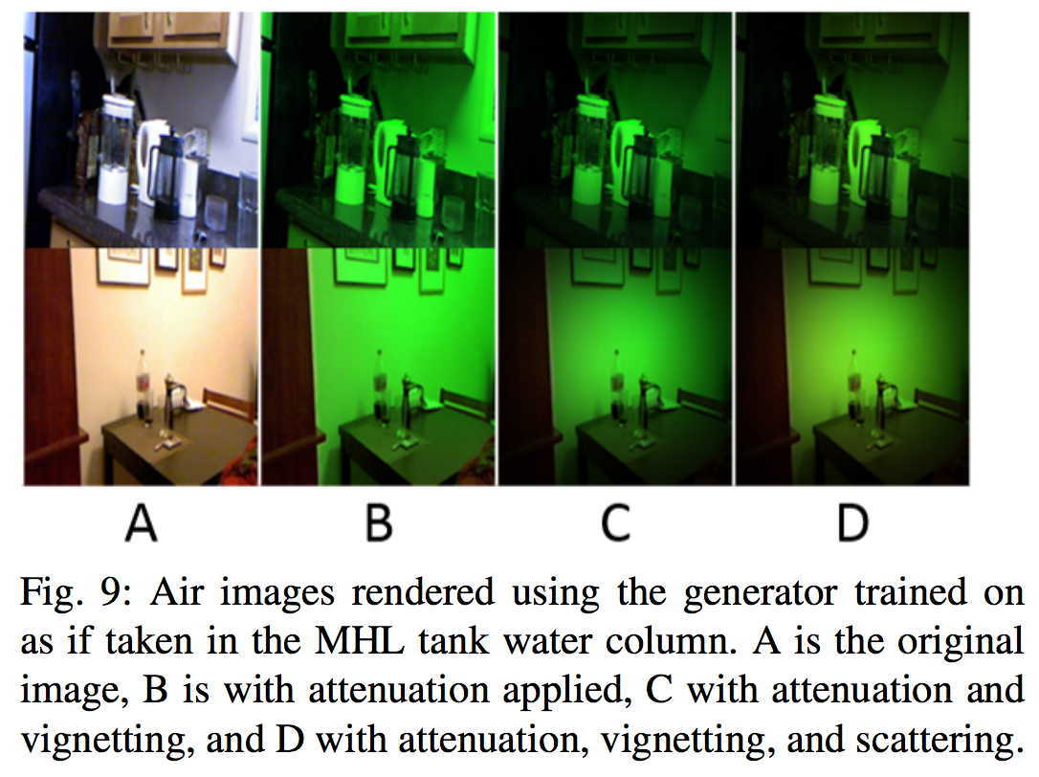
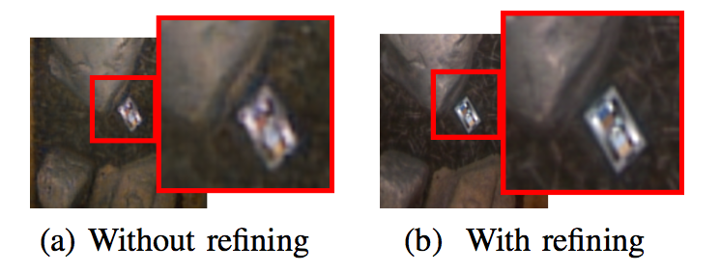

Slide 19
Discussion
we would like to experiment with adding additional layers to this stage for capturing more complex effects, such as lighting patterns from sunlight in shallow water surveys.

Slide 21
